Slide 1
“THEORY OF AUTOMATA”
Nondeterministic Finite Automaton (NFA)

Slide 2
Summary
converting NFA to FA (method 3), example, NFA and Kleene’s theorem method 1, examples, NFA and Kleene’s theorem method 2 , NFA corresponding to union of FAs, example

Slide 3
Method 3:
As discussed earlier that in an NFA, there may be more than one transition for a certain letter and there may not be any transition for certain letter, so starting from the initial state corresponding to the initial state of given NFA, the transition table along with new labels of states, of the corresponding FA, can be built introducing an empty state for a letter having no transition at certain state and a state corresponding to the combination of states, for a letter having more than one transitions. Following are the examples

Slide 4

Example
Consider the following NFA which accepts the language of strings containing bb
Using the method discussed earlier, the transition table corresponding to the required FA may be constructed as

Slide 5
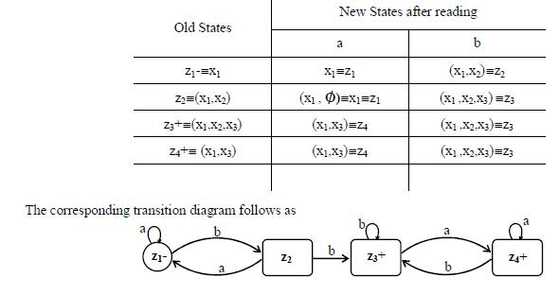

Slide 6
NFA and Kleene’s Theorem
It has been discussed that, by Kleene’s theorem part III, there exists an FA corresponding to a given RE. If the given RE is as simple as r = aa+bbb or r = a(a+b)*, the corresponding FAs can easily be constructed. However, for a complicated RE, the RE can be decomposed into simple REs corresponding to which the FAs can easily be constructed and hence, using the method, constructing the FAs corresponding to sum, concatenation and closure of FAs, the required FA can also be constructed. It is to be noted that NFAs also help in proving Kleene’s theorem part III, as well. Two methods are discussed in the following

Slide 7
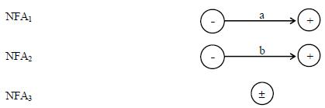
NFA and Kleene’s Theorem
Method 1:
The method is discussed considering the following example
Example
To construct the FAs for the languages L₁ = {a}, L₂ = {b} and L₃ = {Λ}
Step 1: Build NFA₁, NFA₂ and NFA₃ corresponding to L₁, L₂ and L₃ , respectively as shown in the following diagram

Slide 8
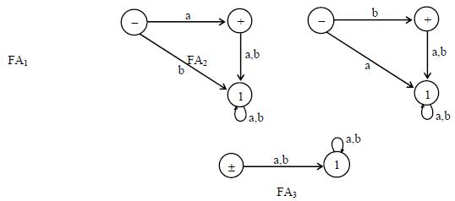
Step 2:
As discussed earlier for every NFA there is an FA equivalent to it, hence there must be FAs for the above mentioned NFAs as well. The corresponding FAs can be considered as follows

Slide 9
NFA and Kleene’s Theorem method 2
It may be observed that if an NFA can be built corresponding to union, concatenation and closure of Fas corresponding to the REs, then converting the NFA, thus, obtained into an equivalent FA, this FA will correspond to the given RE. Followings are the procedures showing how to obtain NFAs equivalent to union, concatenation and closure of As
NFA corresponding to Union of Fas
Method :
Introduce a new start state and connect it with the states originally connected with the old start state with the same transitions as the old start state, then remove the –ve sign of old start state. This creates non-determinism and hence results in an NFA.

Slide 10
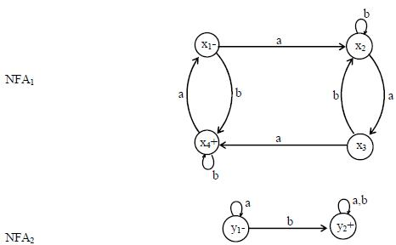
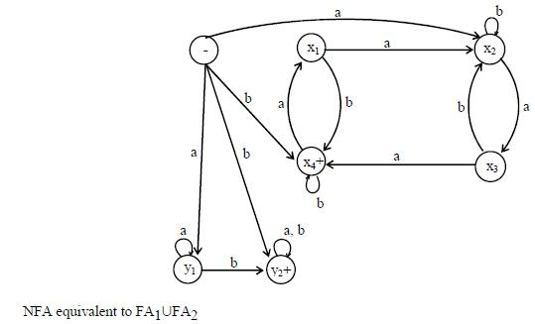
Example

Slide 11
NFA corresponding to Concatenation of FAs
Method :
Introduce additional transitions for each letter connecting each final state of the first FA with the states of second FA that are connected with the initial state of second FA corresponding to each letter of the alphabet. Remove the +ve sign of each of final states of first FA and –ve sign of the initial state of second FA. It will create non-determinism at final states of first FA and hence NFA, thus obtained, will be the required NFA

Slide 12
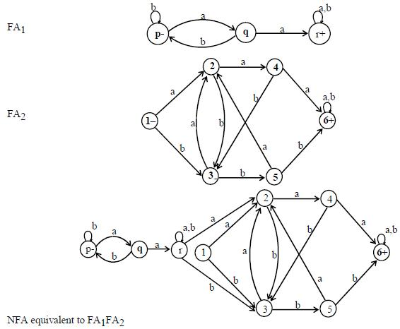
Example (No FA accepts Null string)

Slide 13
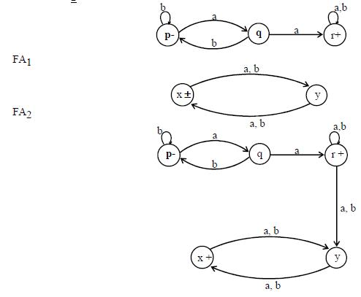
Example (FA2 accepts Null string)

Slide 14
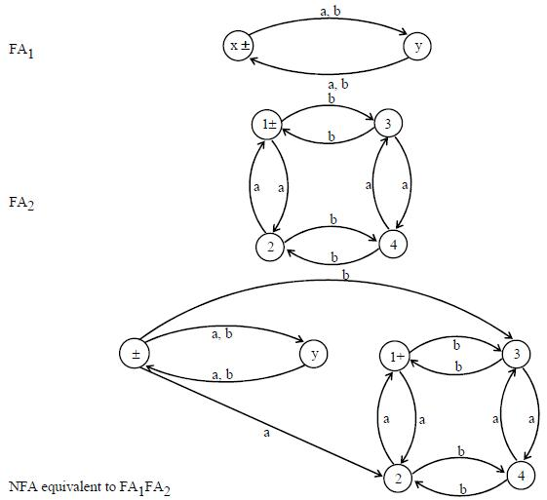
Example (Both FAs accept Null string)

Slide 15
NFA corresponding to the Closure of an FA
Apparently, it seems that since closure of an FA accepts the Null string, so the required NFA may be obtained considering the initial state of given FA to be final as well, but this may allow the unwanted string to be accepted as well. For example, an FA, with two states, accepting the language of strings, defined over. Σ= {a,b}, ending in a, will accept all unwanted strings, if the initial state is supposed to be final as well
Method
Thus, to accommodate this situation, introduce an initial state which should be final as well (so that the Null string is accepted) and connect it with the states originally connected with the old start state with the same transitions as the old start state, then remove the –ve sign of old start state. Introduce new transitions, for each letter, at each of the final states (including new final state) with those connected with the old start state.This creates non-determinism and hence results in the required NFA.

Slide 16

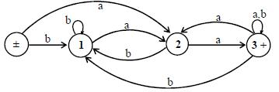
Example
Consider the following FA
It may be observed that the FA* accepts only the additional string which is the Null string. Considering the state 1 to be final as well, will allow the unwanted strings be accepted as well. Hence the required NFA is constructed introducing the new initial state, shown below

Slide 17

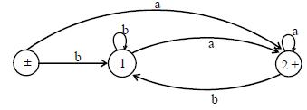
Example
Consider the following FA
It may be observed that the FA* accepts only the additional string which is the Null string As observed in the previous example the required NFA can be constructed only if the new initial state is introduced as shown below.

Slide 18
Memory required to recognize a language
Memory required to recognize a language means to look at the machine which can recognize a language. As an FA can be considered to be a machine which is simple model of computation and every regular language is associated with certain FA, so to recognize a language there is a restriction that there is a single pass from left to right for any string to decide whether it belongs to certain language ? This helps to remember the information about the initial part of the string read so far. By this process the input string is examined and the string is decided either to be in a certain language or not. Consider L = {w OE {a,b}*: w neither ends in ab nor in ba}. i.e. L is the language of strings, defined over Σ = {a,b}, consisting of Λ, a, b and strings ending in aa or bb. L may be accepted by the following FA

Slide 19
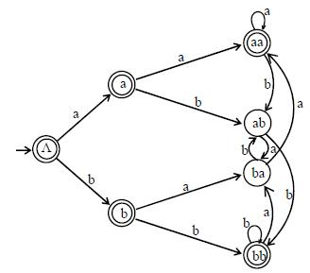
As seen in the above FA, seven states are required to recognize the language L, while on the other hand it is very hard to recognize the language PALINDROME. As seen in the above example of FA, seven states are required to recognize that language. Now consider another language L₃ of strings of length three or more, defined over Σ= {a,b}, and the third letter from the right is a. As discussed by Martin, there is a straight forward method to build an FA recognizing L₃ i.e. a distinct state for every possible substring of length less then or equal to 3. It is obvious that for each length i, i=0,1,2,3, of substring, the number of states are 2i and thus total number of states required to recognize the language L₃ are 2⁰+2¹+2²+2³ = 2³⁺¹-1=15 (using 2⁰+2¹+2²+…+ 2^{n}= 2^{n+1}-1)

Slide 20
Distinguishable strings and Indistinguishable strings
Two strings x and y, belonging to Σ*, are said to be distinguishable w.r.t a language L ≤ Σ* if there exists a string z belonging to Σ* s.t. xz L but yz oe L or xz oe L but yz OE L . Two strings x and y, belonging to *, are said to be indistinguishable with respect to a language L * if for every string z belonging to *, either both xz or yz OE L or both don’t belong to L.
Example
Let L be the language of strings, defined over Σ = {0,1}, ending in 01.
The strings 110 and 010011 are distinguishable w.r.t L, as there exists 1 belonging to Σ* s.t. 1101 belongs to L but 0100111 doesn’t belong to L. But 111 and 010011 are indistinguishable, for 1 belonging to Σ* s.t. both 1111 and 010011 don’t belong to L i.e. for every z belonging to Σ*, either both 111z and 01001z belong to L, or both don’t belong to L.

Slide 21
Theorem
Statement
If L is a language over an alphabet Σ and for integer n there are n strings from Σ*, any two of which are distinguishable w.r.t. language L, then any FA recognizes L must have at least n states. (Note: There may not exist any FA which recognizes the given language.)

Slide 22
Proof
Let S be set of strings, any two of which are distinguishable w.r.t. language L. Let F₁ be the FA which recognizes the language L. To prove the theorem, it is sufficient to show that any two strings under F₁ must be ended in different states i.e. corresponding to each string x belonging to S, F₁ ends in distinct states. This if S has n strings then it is to be shown that F₁ has at least n states Let x and y be any two strings from S. By supposition any two strings of S are distinguishable w.r.t. L, so there exists a string z belonging to A*such that only one of xz and yz belongs to L i.e.F₁ ends in a final state either for xz or yz which shows that F₁ ends in distinct states for xz and yz. Let F₁ be ended in same state for both the strings x and y, which shows that F₁ends in same state for both xz and yz, a contradiction as x and y being distinguishable implies xz and yz are ended at distinct states of F₁. Hence F₁ does not end in a same state for both strings x and y, which shows that each pair of strings belonging to S ends in different states. Hence F₁ must contain at least n states.

Slide 23

Example of previous Theorem
Let L₂₀={w {0,1}*: |w| ≥ 20 and the 20th letter of w, from right is, 1}. Let S be the set of all strings of length 20, defined over Σ , any two of which are distinguishable w.r.t. L₂₀. Obviously the number of strings belonging to S, is 2²⁰. Let x and y be any two distinct strings i.e. they differ in ith letter, i=1,2,3,…20, from left. For i=1, they differ by first letter from left. Then by definition of L₂₀, one is in L₂₀ while other is not as shown below

Slide 24

So they are distinct w.r.t. L₂₀ for z = Λ i.e. one of xz and yz belongs to L₂₀. Similarly if i=2 they differ by 2nd letter from left and are again distinguishable and hence for z belonging to Σ *, |z|=1, either xz or yz belongs to L₂₀ because in this case the 20th letter from the right of xz and yz is exactly the 2nd letter from left of x and y as shown below
Hence x and y will be distinguishable w.r.t. L₂₀ for i=2, as well. Continuing the process it can be shown that any pair of strings x and y belonging to S, will be distinguishable w.r.t. L₂₀. Since S contains 2²⁰ strings, any two of which are distinguishable w.r.t. L₂₀, so using the theorem any FA accepting L₂₀ must have at least 2²⁰ states.

Slide 25
Finite Automaton with output
Finite automaton discussed so far, is just associated with the RE or the language. There is a question whether does there exist an FA which generates an output string corresponding to each input string ? The answer is yes. Such machines are called machines with output. There are two types of machines with output. Moore machine and Mealy machine

Slide 26
Moore machine
A Moore machine consists of the following
A finite set of states q₀, q₁, q₂, … where q₀ is the initial state.
An alphabet of letters = {a,b,c,…} from which the input strings are formed.
An alphabet Σ={x,y,z,…} of output characters from which output strings are generated.
A transition table that shows for each state and each input letter what state is entered the next.
An output table that shows what character is printed by each state as it is entered.
Note
It is to be noted that since in Moore machine no state is designated to be a final state, so there is no question of accepting any language by Moore machine. However in some cases the relation between an input string and the corresponding output string may be identified by the Moore machine.

Slide 27
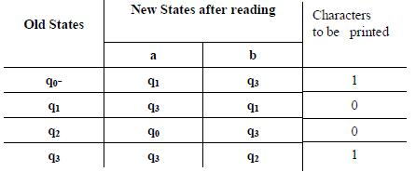
Example
Consider the following Moore machine having the states q₀, q₁, q₂, q₃ where q₀ is the start state and
Σ = {a,b},
Ѓ={0,1}
the transition table follows as

Slide 28
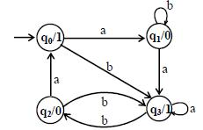
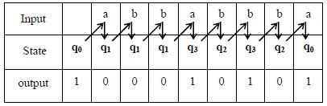
the transition diagram corresponding to the previous transition table may be
It is to be noted that the states are labeled along with the characters to be printed. Running the string abbabbba over the above machine, the corresponding output string will be 100010101, which can be determined by the following table as well
It may be noted that the length of output string is l more than that of input string as the initial state prints out the extra character 1, before the input string is read

Slide 29
Mealy machine
A Mealy machine consists of the following
A finite set of states q₀, q₁, q₂, … where q₀ is the initial state.
An alphabet of letters Σ = {a,b,c,…} from which the input strings are formed.
An alphabet Ѓ={x,y,z,…} of output characters from which output strings are generated.
A pictorial representation with states and directed edges labeled by an input letter along with an output character. The directed edges also show how to go from one state to another corresponding to every possible input letter.a

Slide 30
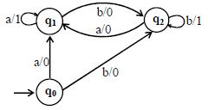
Example
Consider the following Mealy machine having the states q₀, q₁, q₂ , where q₀ is the start state and
Σ = {a,b},
Ѓ ={0,1}
It is observed that in the above Mealy machine, if in the output string the nth character is 1, it shows that the nth letter in the input string is the second in the pair of double letter. For babaababba as input string the machine will print 0000100010.

Slide 31
Constructing the incrementing machine
In the previous example of complementing machine, it has been observed that the input string and the corresponding output string are 1’s complement of each other. There is a question whether the Mealy machine can be constructed, so that the output string is increased, in magnitude, by 1 than the corresponding input string? The answer is yes.
This machine is called the incrementing machine. Following is how to construct the incrementing machine. Before the incrementing machine is constructed, consider how 1 is added to a binary number. Since, if two numbers are added, the addition is performed from right to left, so while increasing the binary number by 1, the string (binary number) must be read by the corresponding Mealy machine from right to left, and hence the output string (binary number) will also be generated from right to left.

Slide 32

Consider the following additions
It may be observed from the above that If the right most bit of binary number, to be incremented, is 0, the output binary number can be obtained by converting the right most bit to 1 and remaining bits unchanged. If the right most bit of binary number is 1 then the output can be obtained, converting that 1 along with all its concatenated 1’s to 0’s, then converting the next 0 to 1 and remaining bits unchanged. The observations (a) and (b) help to construct the following Incrementing (Mealy) machine. The Mealy machine have the states q₀, q₁, q₂ , where q₀ is the start state and Σ = {0,1},
Ѓ={0,1}

Slide 33
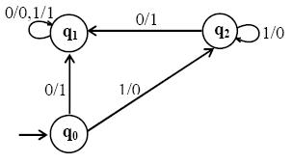
It may be observed that, in the incrementing machine, if 0 is read at initial state q0, that 0 is converted to 1 and a no change state q1 (no carry state) is entered where all 0’s and all 1’s remain unchanged. If 1 is read at initial state, that 1 is converted to 0 and the state q2(owe carry state) is entered, where all 1’s are converted to 0’s and at that state if 0 is read that 0 is converted to 1 and the machine goes to no change state. If the strings 100101110 and 1001100111 are run over this machine, the corresponding output strings will be 100101111 and 1001101000 respectively.

Slide 34
Link
http://www.cs.berkeley.edu/~luca/cs172/notemindfa.pdf
http://vulms.vu.edu.pk/Handouts/cs402_1.zip

